Slide 1

A data visualization course for undergraduate data science students
Silas Bergen
Winona State University; Winona, MN, USA
JSM 2016

Slide 2
Context
Spring 2015: Winona State launches Data Science major. Core consists of:
Statistics:
Introductory statistics
Intermediate statistics
Regression analysis
Computer science:
Algorithms and Problem-Solving I and II
Databases and Management Systems
Data science:
Introductory Data Science
Data Summary and Visualization
Management of Structured Data
STAT
CS
STAT

Slide 3
Context
Data science:
Introductory Data Science
Data Summary and Visualization
Management of Structured Data
Data viz (1st-time offering Fall ‘15; 14 students; 20 currently enrolled for Fall ‘16)
Intro to DSCI
(1st-time offering Spring 2015)
Structured data
SEMESTER 1
SEMESTER 2

Slide 4
Course outline
Visualization theory and best practices (~3 weeks)
Draws from Tufte, Cleveland & McGill, Wickham
Critique-based; no designs
Assessments: weekly visualization critiques
2. Visualization design (~8 weeks)
Data visualization:
Bar graphs and variants
Scatterplots
Time-trend plots
Mapping
Interactive & Static dashboards
Tool: Tableau
Assessments: “Design tasks”
3. Projects (~4 weeks)
1 group; 2 individual
First project: data provided
Second project: data scraped
Final project: data found by student
In-class work
Oral presentations

Slide 5
Tableau
PROS
Point-and-click interface
Easy interactivity (crosstalk-style)
Dashboards
Tableau Public for online sharing
CONS
Easy interactivity
Only Tableau Public is free, generally
Minimal data manipulation and analytic capabilities

Slide 6
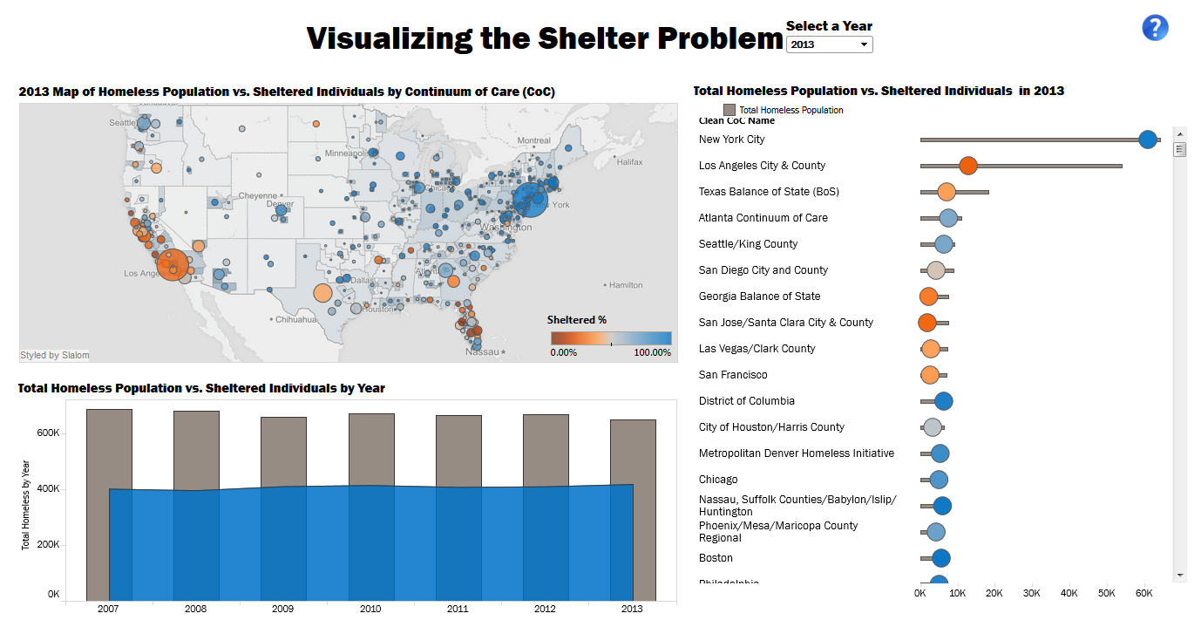
1. Visualization theory and best practices: Critique example
What are the variables encoded in this visualization, and what are the EPTs used to encode them?
Do you think the bar/area chart in the lower left is effective? If so, explain why. If it could be improved, explain how.
How is funding encoded? There is one relationship I would really be interested to explore, but which this visualization makes very difficult. Can you think what that might be, and how could this relationship be visualized effectively?
http://mmviz.blogspot.co.uk/2015/03/visualizing-shelter-problem.html

Slide 7
2. Visualization design: Design task example
Using the American Community Survey data, create 3 visualizations that address the following question: how does inequity in median income comparing employed men to employed women vary across the country? The 3 visualizations should be:
A map with median income inequality encoded by color.
A map with median income inequality encoded by size.
A third visualization which is not a map of your own design.

Slide 8
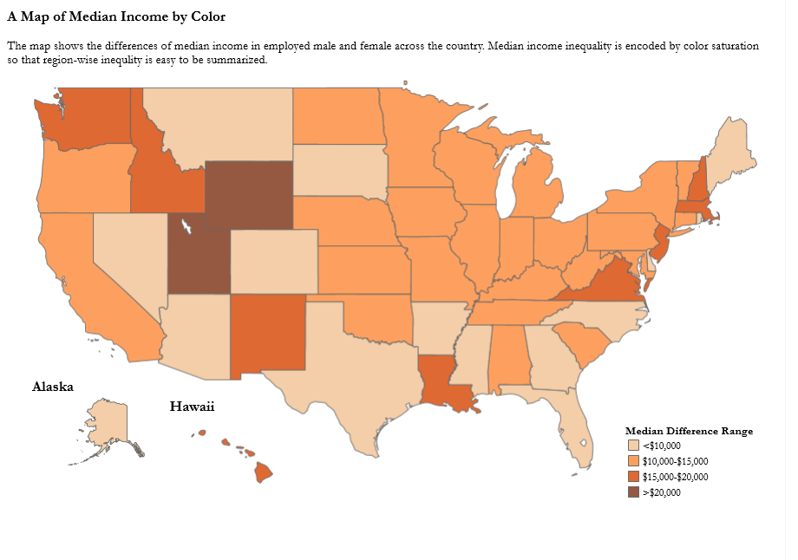
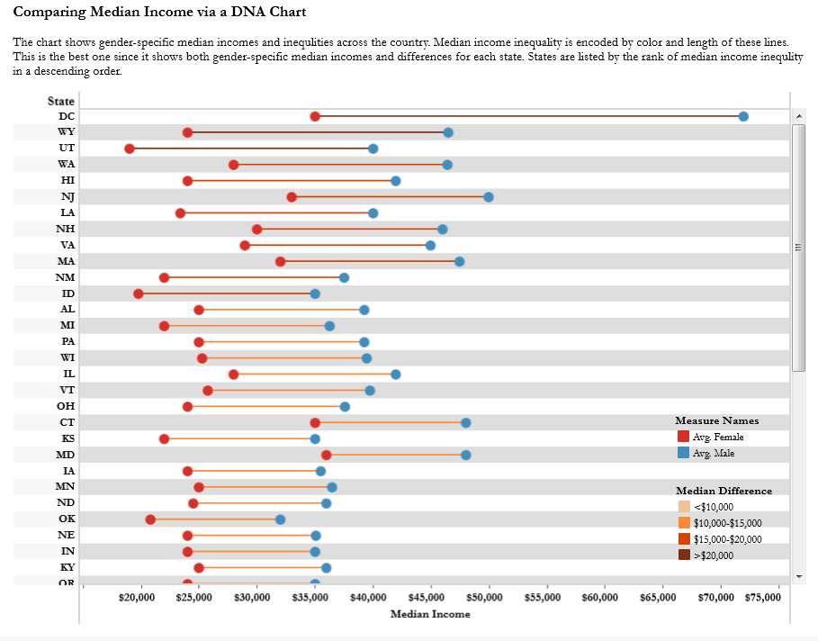
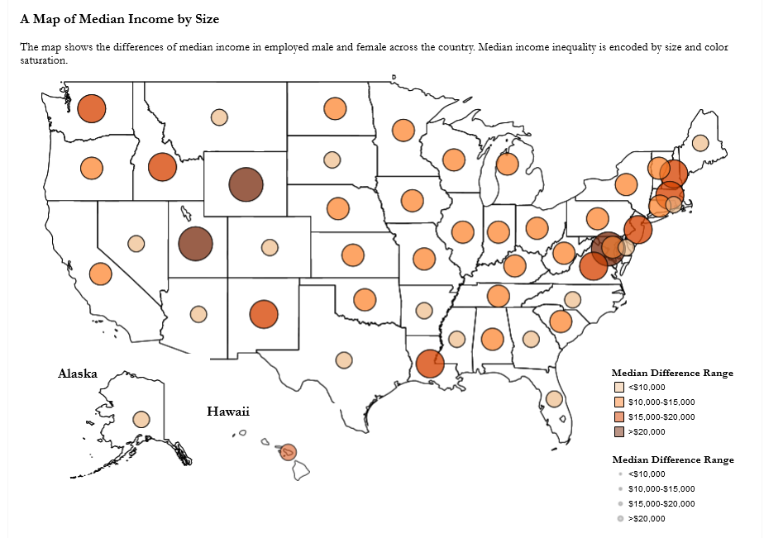
2. Visualization design: Design task example

Slide 9
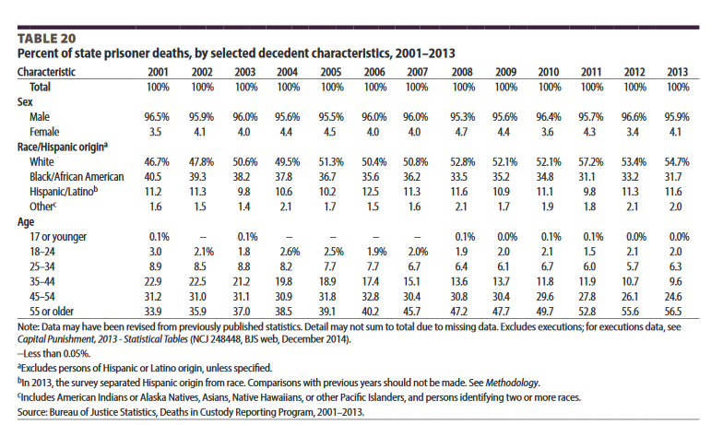

3. Projects
Group Project #1:
Task: create a visual report of the “Mortality in Local Jails and State Prisons” BJS report.
http://www.bjs.gov/latestreleases.cfm

Slide 10
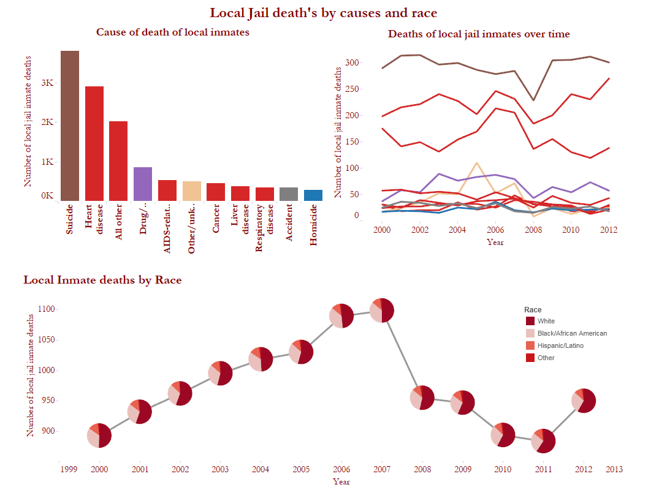
3. Projects

Slide 11
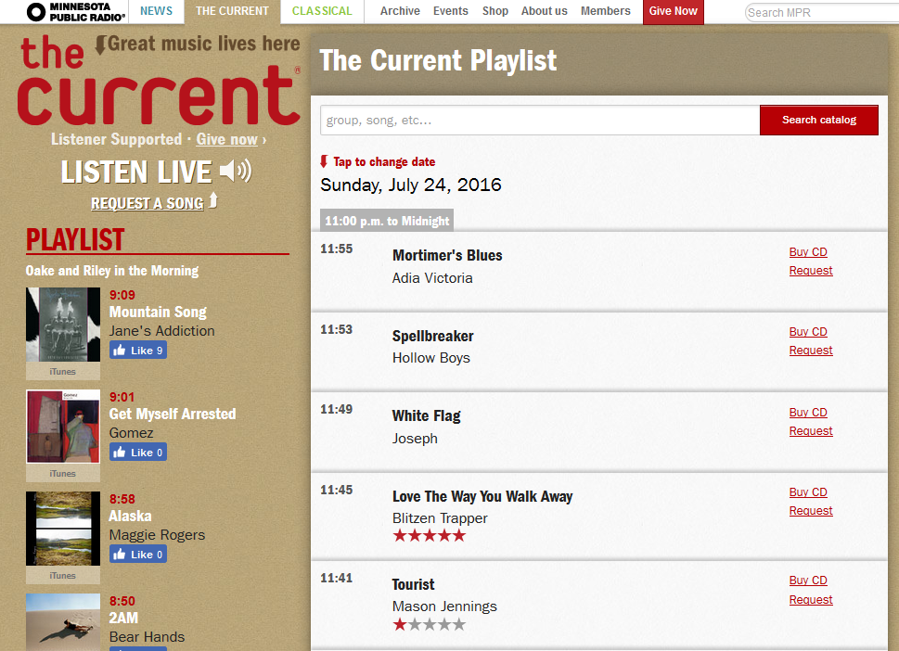
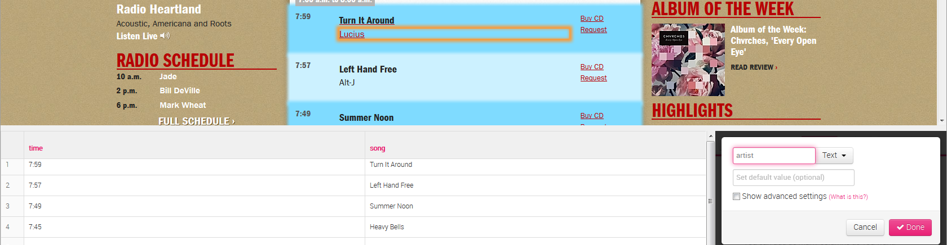
3. Projects
Individual Project #2:
Visualize The Current’s 2015 YTD playlist (www.thecurrent.org/playlist/)

Slide 12
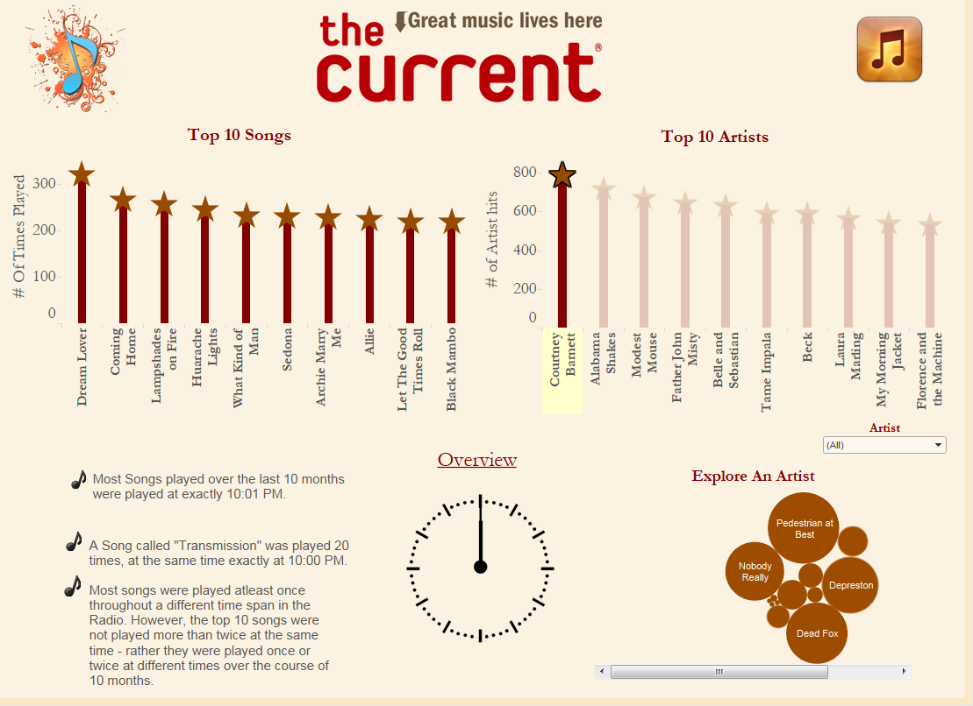
3. Projects
http://tabsoft.co/2aRNVMD

Slide 13
3. Projects
Final project: Student-selected data source
One interactive dashboard, one static dashboard

Slide 14
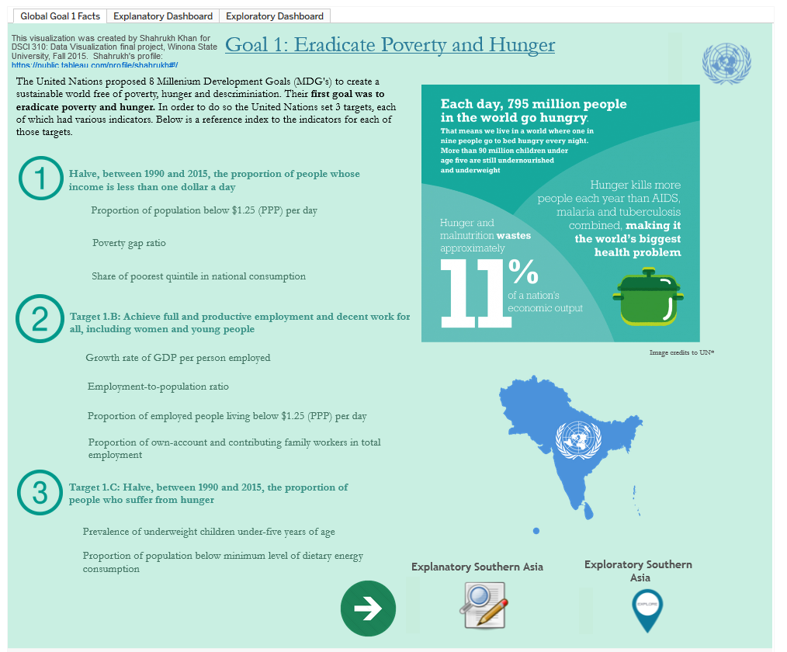
http://tabsoft.co/1UmY2UQ

Slide 15
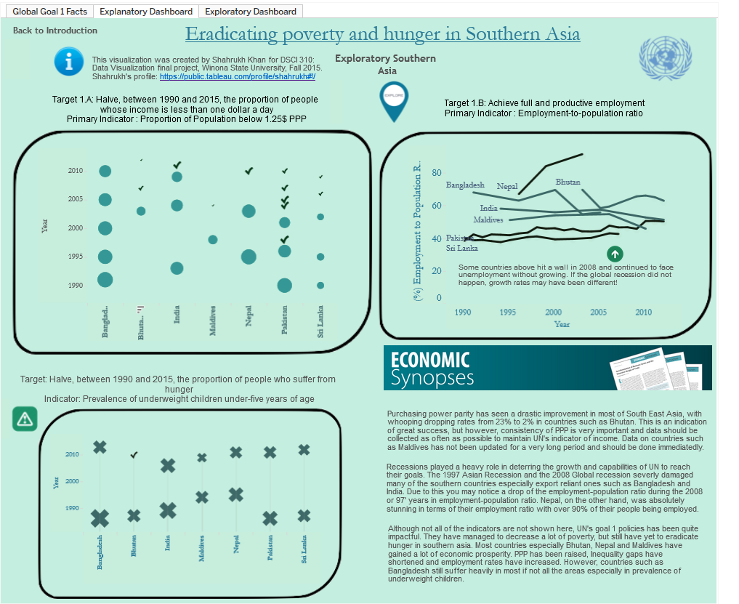
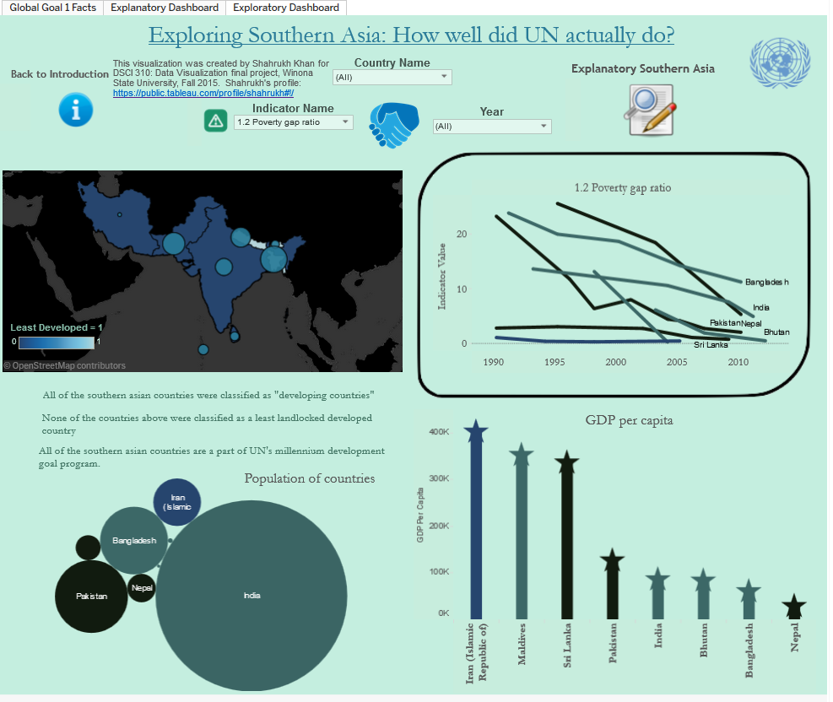
http://tabsoft.co/1UmY2UQ

Slide 16
Biggest challenges/possible solutions
Challenge #1: Helping students improve
Peer review
Editing cycles (Github?)
Challenge #2: Teaching creativity
“Advanced techniques in Tableau” section
Designing “Viz of the week” data
Challenge #3: Teaching intentionality: moving from exploration to insight
Pre-design visualization plans
ggplot & the power of the static viz

Slide 17
THANK YOU!
sbergen@winona.edu

